Slide 1

Excel Beg to Adv

Slide 3
Introduction To Excel
Introduction
Interface
Tabs and Ribbons
Document Windows
Navigation Tips
File Menu and Save
Entering Data and Importing Data
Fonts and Alignment
Cut, Copy and Paste
Paste Special
Undo and Redo
Finding and Replacing a Value
Cell Styles
Formatting Numbers and Dates
Comments
Assignment

Slide 4
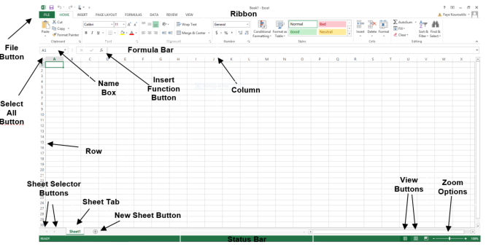
https://www.w3schools.com/excel/excel_introduction.php

Slide 5
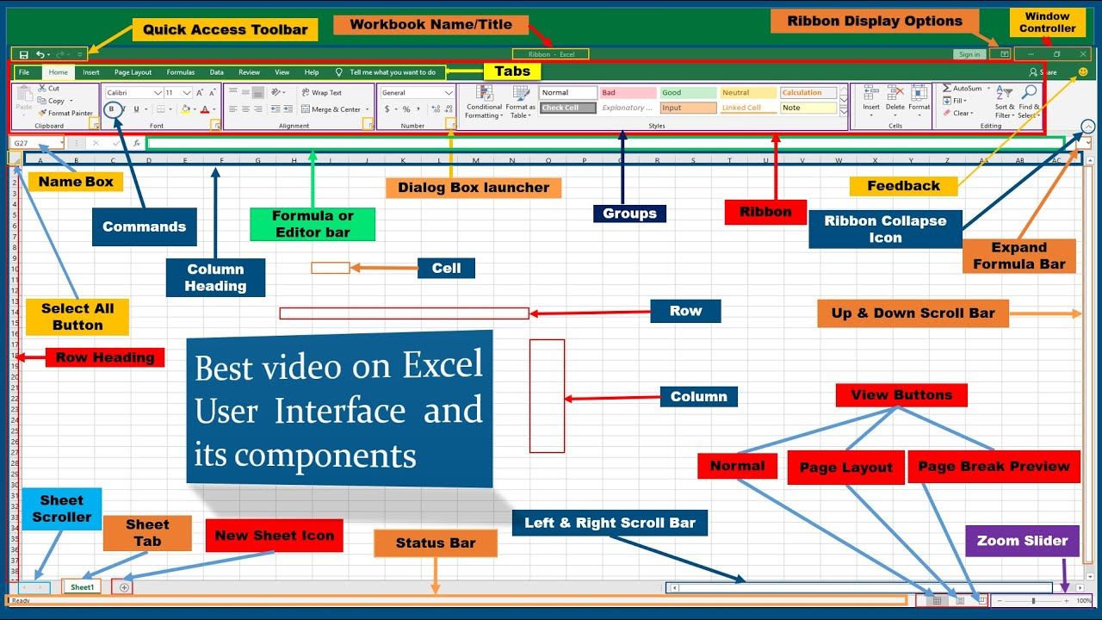

Slide 6
Formula and Function
Introduction to Formulas
Creating Formulas using Operators (=a1+b1) ,+,-,*,
AutoSum (sum ,min,max,count,count,avg)
Common Formulas
Formulas Tab
Copying Formulas
Date Functions (Today, date, datediff, edate,day,month, year,now, weeknum,)
Text Functions (char,concatenate,find, len, lower,upper, mid, left, right,proper, replace,substitute, text,trim)
Assignment
Logical- And,or ,not, if ,iferror,
Lookup- column,row, vlookup,hlookup,index,match,offset,Hstack , xlookup
Maths – abs, aggregate, round,celing ,floor, sumproduct
https://colab.research.google.com/drive/1dFIXOcgOBbZ1HYbBCY9RQWsxfi72FrPC#scrollTo=aP4mLf_RKtus
https://support.microsoft.com/en-us/office/excel-functions-by-category-5f91f4e9-7b42-46d2-9bd1-63f26a86c0eb

Slide 7
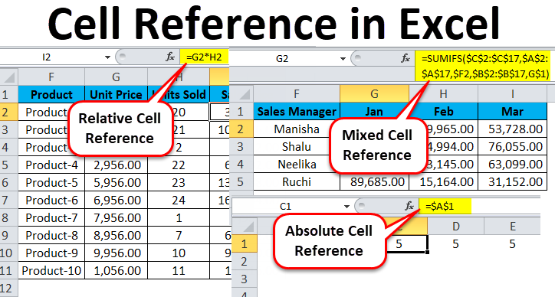
Formula Referencing
Relative References
Absolute References
Mixed References
Multiple Sheet References
Consolidating Data
Tracing the Precedents and Dependents
Using Watch Window and Formula Evaluation
Assignment
https://www.educba.com/cell-reference-in-excel/

Slide 8
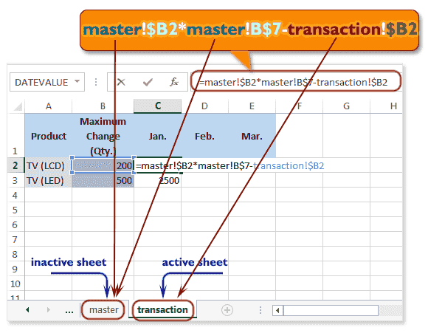
Multiple Sheet References
https://www.w3resource.com/excel/excel-cell-reference.php

Slide 9
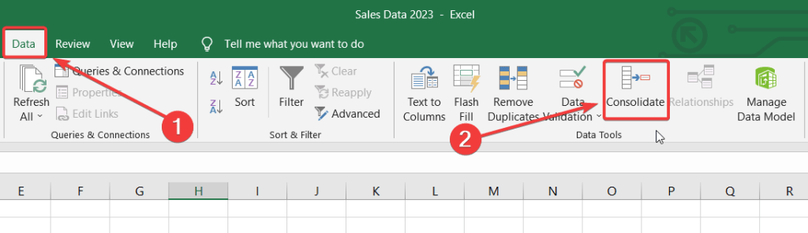
Consolidating Data
Tracing the Precedents and Dependents
Using Watch Window and Formula Evaluation
https://blog.coupler.io/consolidate-data-in-excel/
https://www.onlyoffice.com/blog/2023/11/trace-precedents-and-dependents-in-excel
https://www.customguide.com/excel/watch-window-excel

Slide 10
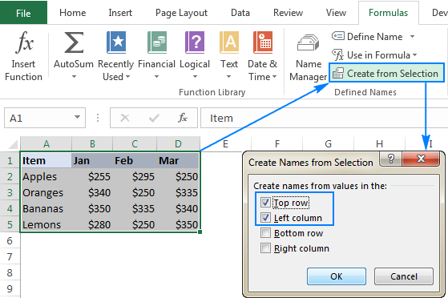
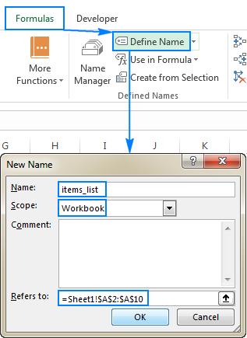
Named Ranges
Defined Names
Named Ranges
Formulas with named ranges
Assignment
https://www.ablebits.com/office-addins-blog/excel-named-range/

Slide 11
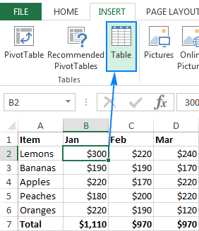
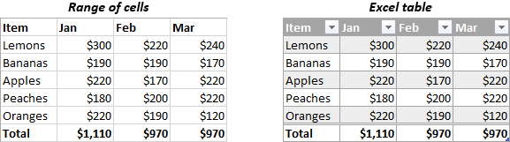
Table in Excel
Insert a Table and Style Options
Add Rows and Columns
Perform a Function in a Table
Assignment
https://www.ablebits.com/office-addins-blog/excel-table-tutorial/

Slide 12
AutoFill and Custom Lists
AutoFill a Series
AutoFill Non-Adjacent Cells
AutoFill on Multiple Sheets
Creating Custom Lists
Series Formatting
Sorting using Custom List
Assignment
AutoFill is used to fill a series of numbers, dates, or text automatically based on a pattern you define.
2. AutoFill Non-Adjacent Cells
AutoFill can be used for non-adjacent cells if you first select the non-contiguous range.
Steps:
Select the first cell, then hold Ctrl and click on the non-adjacent cells.
Use the AutoFill handle to drag and fill the series.
Example:
Fill every other cell with a number sequence (e.g., 1, 2, 3 in A1, A3, A5, etc.).
https://www.pryor.com/blog/create-a-custom-autofill-series-in-excel/
https://theexceladdict.com/tips/170302_Create_Your_Own_Custom_AutoFill_Lists.html

Slide 13
3. AutoFill on Multiple Sheets
You can fill a series across multiple sheets at once.
Steps:
Select multiple sheets by holding down Ctrl or Shift while clicking on the sheet tabs.
Enter the value in one sheet and use the AutoFill handle.
Excel will fill the same series across all selected sheets.
Example:
If you want to fill the same date range across Sheet1, Sheet2, and Sheet3, select all three sheets and then fill the dates.
4. Creating Custom Lists
Custom Lists allow you to create predefined lists that you can use repeatedly for sorting or AutoFill purposes.
Steps:
Go to File > Options.
Select Advanced, then scroll down to the General section.
Click Edit Custom Lists....
Enter your list (e.g., Product A, Product B, Product C) and click Add.

Slide 14
5. Series Formatting
You can format your AutoFill series based on specific number or date patterns.
Steps:
Enter a starting value (e.g., January 1, 2024).
Click and drag the fill handle while holding the right mouse button.
When you release, select Fill Series or Fill Days, Fill Months, etc., to format it accordingly.
Example:
You can fill dates by month, by year, or skip weekends, depending on the series you choose.
6. Sorting using Custom Lists
You can sort data in a custom order using the lists you create.
Steps:
Select the range of data you want to sort.
Go to the Data tab and click Sort.
In the Order dropdown, choose Custom List....
Select your custom list from the options.

Slide 15
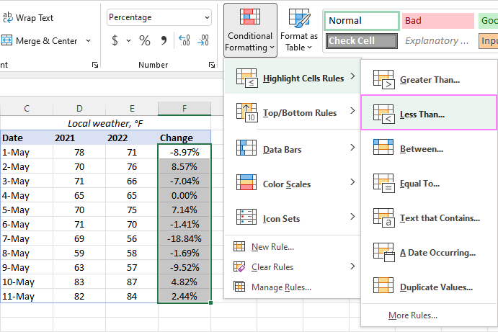
Conditional Formatting
Highlight Cells Rules
Top/Bottom Rules
Data Bars
Color Scales & Icons
Custom Formatting Rule
Assignment
Conditional Formatting allows you to format cells based on specific criteria, making it easy to visualize trends, identify high/low values, or highlight important data.
https://www.ablebits.com/office-addins-blog/excel-conditional-formatting/

Slide 16
Conditional Formatting Overview
Conditional Formatting allows you to format cells based on specific criteria, making it easy to visualize trends, identify high/low values, or highlight important data.
2. Highlight Cells Rules
This feature highlights cells based on predefined rules like values, text, dates, or duplicates.
Steps:
Select the range of cells to apply the rule.
Go to the Home tab and click Conditional Formatting.
Choose Highlight Cells Rules from the dropdown.
Select the condition you want (e.g., Greater Than, Less Than, Text That Contains, etc.).
Define the value or text and set the formatting.
Examples:
Greater Than: Highlight all sales greater than $5000 with a green fill.
Formula: =A1>5000 (for numbers in range A1
).
Text That Contains: Highlight all cells containing the word "Refund".
Formula: =SEARCH("Refund", A1) (for cells in column A).
3. Top/Bottom Rules
Highlights the top or bottom values in a selected range.
Steps:
Select the range.
Go to Conditional Formatting > Top/Bottom Rules.
Choose options like Top 10 Items, Top 10%, Bottom 10%, or Above/Below Average.
Set the formatting style for the selected rule.
Examples:
Top 10 Items: Highlight the top 10 sales values in your dataset.
Bottom 10%: Highlight the bottom 10% of performance scores.

Slide 17
4. Data Bars
Displays horizontal bars inside cells to visually represent the value relative to other cells.
Steps:
Select the range of numeric data.
Go to Conditional Formatting > Data Bars.
Choose a Gradient Fill or Solid Fill style.
Example:
Apply data bars to sales numbers to show performance. Higher values will have longer bars.
5. Color Scales & Icons
Color Scales: Shades cells with different colors based on their value relative to the others.
Icons: Adds symbols (e.g., arrows, traffic lights) based on predefined rules for high, medium, and low values.
Steps:
Select the range.
Go to Conditional Formatting > Color Scales or Icon Sets.
Choose a color scale or icon set.
Examples:
Color Scales: Apply a color scale to a column of numbers to shade low values in red and high values in green.
Icon Sets: Use traffic lights to represent performance levels (green for high, yellow for average, red for low).
6. Custom Formatting Rule
You can create custom formulas for conditional formatting to highlight data based on complex conditions.
Steps:
Select the range.
Go to Conditional Formatting > New Rule.
Select Use a formula to determine which cells to format.
Enter the formula and set the formatting.
Examples:
Custom Formula for Dates: Highlight overdue tasks (dates earlier than today).
Formula: =A1<TODAY()
Custom Formula for Multiple Conditions: Highlight cells where sales are greater than $5000 but less than $10,000.
Formula: =AND(A1>5000, A1<10000)

Slide 18
Assignment: Applying Conditional Formatting in a Dataset
You have been given a Sales Dataset for a store. Your task is to apply various conditional formatting techniques to visualize important information:
Highlight Cells Rules:
Highlight all sales greater than $10,000 with a green fill color in column B (Sales Amount).
Highlight all sales that are less than $2,000 in red.
Top/Bottom Rules:
Highlight the top 5 sales values in column B with blue fill.
Highlight the bottom 10% of sales in column B with orange fill.
Data Bars:
Apply Data Bars to the sales numbers in column B to visually represent the size of each sale.
Color Scales:
Use a Color Scale to shade the sales figures in column B, with lower numbers shaded in red and higher numbers shaded in green.
Custom Formatting Rule:
Create a custom rule to highlight all sales that occurred in the last 7 days (use column D for sale date).
Formula: =TODAY()-D1<=7.
Extra: Custom Formula for Highlighting Rows:
If you want to highlight entire rows based on the value in a particular column:
Example: Highlight rows where the sales amount in column B is greater than $10,000.
Steps:
Select the entire table range.
Go to Conditional Formatting > New Rule.
Choose Use a formula and enter: =$B1>10000.
Apply a fill color to highlight the entire row.
Icon Sets:
Apply Icon Sets (e.g., traffic lights) to the Sales Performance column (C). Use the following criteria:
Green light for values greater than 80.
Yellow light for values between 50 and 80.
Red light for values below 50.

Slide 19
Logical Functions
If statement
Nested If
AND,OR, NOT
IFERROR
SUMIF & COUNTIF
SUMIFS & COUNTIFS
Assignment
Logical Functions in Excel
IF
Syntax: =IF(condition, value_if_true, value_if_false)
Checks if a condition is met and returns a value for true or false.
Nested IF
Syntax: =IF(condition1, value_if_true1, IF(condition2, value_if_true2, value_if_false))
Allows multiple conditions by nesting IF functions for layered logic.
AND
Syntax: =AND(condition1, condition2, ...)
Returns TRUE if all conditions are true; otherwise, returns FALSE.
OR
Syntax: =OR(condition1, condition2, ...)
Returns TRUE if any condition is true; otherwise, returns FALSE.
NOT
Syntax: =NOT(condition)
Reverses the logical value, turning TRUE to FALSE and vice versa.
IFERROR
Syntax: =IFERROR(value, value_if_error)
Returns a specified value if there’s an error; otherwise, returns the original result.
https://books-gyansetu.gitbook.io/advanced-excel/mathematical-functions-sum-sumif-sumifs-count-counta-countif

Slide 20
Conditional Summing and Counting Functions
SUMIF
Syntax: =SUMIF(range, criteria, [sum_range])
Adds values in a range that meet a specific criterion.
COUNTIF
Syntax: =COUNTIF(range, criteria)
Counts the number of cells in a range that meet a specific criterion.
SUMIFS
Syntax: =SUMIFS(sum_range, criteria_range1, criteria1, [criteria_range2, criteria2], ...)
Adds values in a range based on multiple criteria.
COUNTIFS
Syntax: =COUNTIFS(criteria_range1, criteria1, [criteria_range2, criteria2], ...)
Counts the number of cells across multiple ranges that meet multiple criteria.

Slide 21
Reference Functions
VLOOKUP & HLOOKUP
LOOKUP ,INDEX , MATCH,INDIRECT,OFFSET
ROW & COLUMN
Array Formulas
Reference Functions in Excel
Objective: To understand and apply reference functions in Excel for dynamic data retrieval and analysis.
https://chandoo.org/wp/vlookup-match-and-offset-explained-in-plain-english-spreadcheats/
https://excel-practice-online.com/functions/vlookup-function/

Slide 22
Part 1: Lookup Functions
VLOOKUP
Syntax: =VLOOKUP(lookup_value, table_array, col_index_num, [range_lookup])
Use VLOOKUP to find the price of a specific product in a list. Given a table with "Product" in column A and "Price" in column B, retrieve the price of a product from a specified cell.
HLOOKUP
Syntax: =HLOOKUP(lookup_value, table_array, row_index_num, [range_lookup])
Given a horizontal table with regions in row 1 and sales figures in row 2, use HLOOKUP to retrieve the sales for a specific region.
LOOKUP
Syntax: =xLOOKUP(lookup_value, lookup_vector, [result_vector])
Using a list of employee IDs and their names, use LOOKUP to return an employee's name based on a given ID.

Slide 23
Part 2: Reference and Offset Functions
INDEX & MATCH
INDEX Syntax: =INDEX(array, row_num, [column_num])
MATCH Syntax: =MATCH(lookup_value, lookup_array, [match_type])
Use INDEX and MATCH together to retrieve a student's grade based on their name from a list of student names and grades.
INDIRECT
Syntax: =INDIRECT(ref_text, [a1])
Write a formula that uses INDIRECT to reference a range in a separate sheet based on a cell containing the sheet name.
OFFSET
Syntax: =OFFSET(reference, rows, cols, [height], [width])
Use OFFSET to return the value in a cell 2 rows below and 1 column to the right of a specified starting cell.
ROW & COLUMN
ROW Syntax: =ROW([reference])
COLUMN Syntax: =COLUMN([reference])
Use ROW and COLUMN to return the row and column numbers of a specified cell.
Part 3: Array Formulas
Array Formula
Syntax: {=array_formula} (press Ctrl+Shift+Enter for array formula)
Create an array formula to calculate the total sales of items in a list where the quantity is greater than 10 and price is greater than $50.

Slide 24
Data Validation
Define Data Validation Rules
Data Validation Options
Drop-Down Lists
Data Validation using Custom Formulas
Validate the Worksheet
https://www.ablebits.com/office-addins-blog/data-validation-excel/
https://www.geeksforgeeks.org/what-is-data-validation-in-excel/
https://www.datacamp.com/tutorial/data-validation-in-excel
Data validation is a feature that controls the values that can be entered into a cell in a worksheet. It can be used to ensure that data is accurate, consistent, and conforms to company standards. Data validation can be used in Microsoft Excel and Google Sheets.
Here are some data validation options:
Drop-down list: Allows users to select data from a drop-down list
Whole number: Restricts the cell to accept only whole numbers
Decimal: Restricts the cell to accept only decimal numbers
Date: Restricts the cell to accept only dates from a specified range
Time: Restricts the cell to accept only times from a specified range
Text length: Restricts the length of the text
Custom: Allows users to create their own formula for data validation
To apply data validation in Excel:
Select the cells to create a rule for
Select Data > Data Validation
Under Allow, select an option
Under Data, select a condition
Set the other required values
Customize the input message and error alert
Select OK
To remove data validation for a cell, select the cell, then go to Data > Data Tools > Data Validation > Settings > Clear All.

Slide 25
Pivot Table
Create PivotTables
Choosing Fields
Customizing PivotTables Reports
Filtering PivotTables
PivotCharts
https://www.ablebits.com/office-addins-blog/pivot-charts-excel/
https://blog.hubspot.com/marketing/how-to-create-pivot-table-tutorial-ht
https://www.academyoflearning.com/blog/slicers-in-excel-what-they-are-and-how-to-use-them/
https://www.simplilearn.com/tutorials/excel-tutorial/how-to-create-pivot-table-from-multiple-sheets
https://www.ablebits.com/office-addins-blog/excel-slicer-pivot-table-chart/
https://support.microsoft.com/en-us/office/use-multiple-tables-to-create-a-pivottable-b5e3ff48-2921-4e29-be15-511e09b5cf2d
https://www.geeksforgeeks.org/creating-a-data-model-in-excel/

Slide 26
A PivotTable
is an Excel tool used to summarize, analyze, and explore large datasets by automatically grouping and organizing data in a dynamic table.
Purpose: PivotTables make it easy to view data from different perspectives, answer specific questions, and extract insights quickly.
2. Creating a PivotTable
Step-by-Step Process:
Select Your Data: Choose the dataset you want to summarize (ideally in a tabular format with headers).
Insert a PivotTable:
Go to Insert > PivotTable.
Select the data range and choose where to place the PivotTable (new worksheet or existing worksheet).
Set Up the PivotTable: After creating it, the PivotTable Field List will appear on the right.
Practice Activity: Have students create a simple PivotTable from a sample dataset, such as sales data or employee data.
3. Choosing Fields in a PivotTable
Fields and Areas:
The PivotTable Field List shows all the columns (fields) in the dataset.
Fields are dragged into four areas:
Rows: Adds rows to the PivotTable, grouping data vertically.
Columns: Adds columns to the PivotTable, grouping data horizontally.
Values: Contains the data you want to summarize (usually with counts, sums, averages).
Filters: Allows for filtering the entire table by specific values in a chosen field.
Example:
Add "Product" to Rows, "Region" to Columns, and "Sales" to Values.
This setup shows sales by product and region in a summarized grid format.
https://blog.hubspot.com/marketing/how-to-create-pivot-table-tutorial-ht

Slide 27
4. Customizing PivotTable Reports
Value Field Settings: Customize how data in the Values area is calculated:
Right-click on a value field > Value Field Settings.
Options include Sum, Count, Average, Max, Min, etc.
Formatting: Use the Design tab under PivotTable Tools to change styles and formats.
Grouping Data: Group dates by month, quarter, or year, or group numerical data by ranges.
Sorting and Arranging: Sort data by ascending/descending order or by value (e.g., show highest sales first).
Practice Activity: Customize a PivotTable to show total and average sales by product and region.
5. Filtering PivotTables
Filter Area: Use the Filters area in the PivotTable Field List to add fields that filter the entire report.
Label and Value Filters:
Label Filters: Filter by criteria based on labels (e.g., show only products that start with "A").
Value Filters: Filter data by numerical criteria (e.g., show only items with sales > $5000).
Slicers:
Definition: Slicers are visual, clickable buttons used to filter PivotTables.
Adding Slicers: Go to PivotTable Analyze > Insert Slicer and select fields.
Timeline: Use for date-based filtering in PivotTables. Useful for filtering data by time ranges (months, quarters, years).
Practice Activity: Add a filter for "Region" and use slicers for "Product" in a sales data PivotTable.

Slide 28
6. Creating PivotCharts
Definition: A PivotChart is a dynamic chart based on PivotTable data, allowing visual analysis and data exploration.
Steps to Create:
Select a PivotTable, then go to PivotTable Analyze > PivotChart.
Choose a chart type (e.g., bar, column, line) that best represents the data.
Linking with PivotTables: PivotCharts are linked to PivotTables, so any change in the PivotTable (filtering, field adjustments) updates the PivotChart.
Customization Options: Use the Chart Design tab to change the chart style, layout, and formatting.
Practice Activity: Create a PivotChart based on the sales PivotTable, showing sales by product in a bar chart.
7. Summary and Best Practices
Best Practices:
Ensure data is in a clean, tabular format before creating a PivotTable.
Use meaningful field names and avoid merged cells in your dataset.
Use filters and slicers for quick and interactive analysis.
Regularly update the data source if the dataset grows.
Summary:
PivotTables and PivotCharts help users quickly summarize, filter, and visualize data.
Customization options provide flexibility for different data analysis needs.
PivotTables are a powerful tool for data-driven decision-making in Excel.

Slide 29
Data Visualization
Creating Graphs
Chart Types
Identifying Chart Components
Inserting a Chart in a Worksheet?
Customizing Graphs?
Using the Graph Templates
Sparklines
Trendlines and Forecast Sheet
1. Creating Graphs
Definition: Graphs in Excel represent data visually, helping to convey insights more effectively.
Steps to Create a Graph:
Select Data: Highlight the dataset to visualize.
Insert Chart: Go to Insert > Charts and select a chart type.
Activity: Have students create a basic chart from a sample dataset, like monthly sales or budget data.
2. Chart Types
Column Chart: Compares data across categories.
Bar Chart: Similar to a column chart but horizontal.
Line Chart: Ideal for showing trends over time.
Pie Chart: Shows parts of a whole, useful for percentages.
Scatter Plot: Displays relationships between two variables.
Area Chart: Highlights changes over time.
Activity: Select an appropriate chart type for a given dataset and explain why it’s a good fit.
3. Identifying Chart Components
Title: Explains what the chart represents.
Axes: Horizontal (X-axis) and vertical (Y-axis) lines showing data scales.
Legend: Describes colors/patterns used in the chart.
Data Labels: Displays specific values directly on the chart.
Gridlines: Provides reference lines for data points.
Activity: Label components of an existing chart to reinforce understanding.
https://blog.hubspot.com/marketing/how-to-build-excel-graph

Slide 30
7. Sparklines
Definition: Sparklines are small, in-cell charts that show trends in a row of data.
Types:
Line: Shows trends over time.
Column: Visualizes values as bars.
Win/Loss: Highlights positive and negative values.
Steps to Insert:
Go to Insert > Sparklines and select the data range.
Activity: Insert sparklines in a table to show monthly sales trends.
4. Inserting a Chart in a Worksheet
Steps to Insert:
Select Data: Highlight your data range.
Go to Insert > Charts: Choose the desired chart.
Position Chart: Drag the chart to place it within the worksheet.
Activity: Insert and position a chart in the worksheet.
5. Customizing Graphs
Customization Options:
Chart Design Tab: Modify colors, styles, and layout.
Format Axis: Adjust scales and label formats.
Legend and Data Labels: Add or reposition for clarity.
Themes: Apply Excel themes for a consistent look.
Activity: Customize a chart’s appearance to improve readability.
8. Trendlines and Forecast Sheet
Trendlines:
Purpose: Show data trends over time.
How to Add: Select the chart > Chart Elements > Trendline.
Types: Linear, exponential, moving average.
Forecast Sheets:
Purpose: Projects future data based on historical trends.
How to Create:
Go to Data > Forecast Sheet and select forecast settings.
Activity: Add a trendline to a chart and create a forecast sheet for the next 12 months.
6. Using Graph Templates
Purpose: Graph templates allow saving and reusing custom chart designs.
How to Create a Template:
Activity: Create a custom chart template and apply it to a new chart.

Slide 31
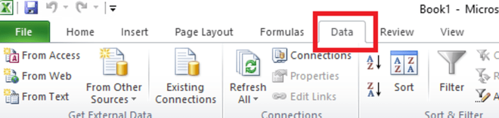
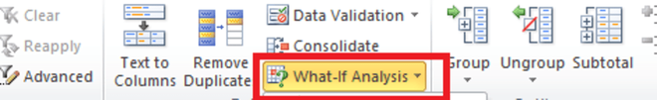
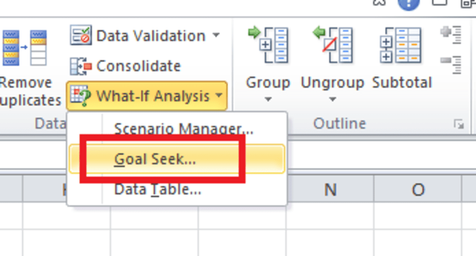
What-if Analysis
Scenario Manager
Goal Seek
Data Table
Solver Too
https://www.youtube.com/watch?v=SYvjwK3oP1A solver
https://www.youtube.com/watch?v=sS6AMm3ooEM
https://www.geeksforgeeks.org/what-if-analysis-with-data-tables-in-excel/

Slide 32
Macros & VBA
Enabling the Developer Tab
Recording a Task
Executing and Deleting a Recorded Task
Customizing the Automated Tasks
https://www.youtube.com/watch?v=AI_Ug-YJvF4 MIS Reports automate publishing with excel vba
https://www.educba.com/examples-of-excel-macros/
https://www.educba.com/vba-macros/
https://www.educba.com/vba-login/
https://www.educba.com/vba-iserror/
Advanced Excel VBA Macros Training for MIS Report Automation https://youtu.be/pcm-xKAo2_M?feature=shared
MIS Report in Excel https://www.youtube.com/watch?v=wwCy1VaaUwk

Slide 33
Excel with AI
Enabling Chat GPT Ad In and exploring Formulas
power pivot (data model)
power query
buttons in dashboard
https://www.simplilearn.com/tutorials/excel-tutorial/slicers-in-excel
Data Cleaning in Excel https://youtu.be/q7EpoOwBcnM?feature=shared

Slide 34
Microsoft Power Pivot is a data modeling and analysis tool in Excel that allows users to create data models, establish relationships, and perform calculations:
Data modeling: Create a tabular model to import, relate, and analyze data from various sources
Relationships: Establish relationships between data
Calculations: Create complex or simple calculations using Data Analysis Expressions (DAX)
Data analysis: Perform information analysis rapidly and share insights easily
Power Pivot is one of three data analysis tools in Excel, along with Power Query and Power View.
Here are some things to know about Power Pivot:
Any data imported into Excel is available in Power Pivot, and vice versa
The data model in a workbook in Excel is the same data model in the Power Pivot window
Tables in Power Pivot must have the same number of columns in each row, and all rows in a column must contain the same data type
A DAX formula in a column is always applied to the entire set of values in the column
https://www.simplilearn.com/tutorials/excel-tutorial/excel-power-pivot
https://www.toptal.com/finance/excel-experts/powerpivot-for-excel-use-cases-and-tutorial
https://support.microsoft.com/en-us/office/power-pivot-overview-and-learning-f9001958-7901-4caa-ad80-028a6d2432ed
https://www.goskills.com/Excel/Resources/How-to-use-PowerPivot

Slide 35
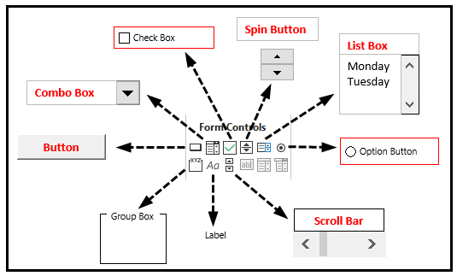
POWER QUERY
https://www.simplilearn.com/tutorials/excel-tutorial/power-query-in-excel
CONTROLS
https://www.wallstreetmojo.com/form-controls-in-excel/
https://www.customguide.com/excel/excel-forms
https://www.educba.com/form-controls-in-excel/
https://excelchamps.com/excel-basics/add-a-button/
https://corporatefinanceinstitute.com/resources/excel/how-to-add-a-vba-button-in-excel/

Slide 36
LEARNING RESOURCE/PRACTICE
https://excel-practice-online.com/
https://excelpractice.online/home
https://excelexercises.com/practice.html?lesson=46
https://nextleap.app/interview-preparation/excel/practice-online
https://www.testgorilla.com/test-library/software-skills-tests/data-analytics-excel-test/
https://www.springboard.com/blog/data-analytics/excel-interview-questions/
https://corporatefinanceinstitute.com/resources/excel/excel-test/
https://colab.research.google.com/drive/1dFIXOcgOBbZ1HYbBCY9RQWsxfi72FrPC#scrollTo=ypOQzwc9JuaS --> excel itvedant

Slide 37
Thank You !

